Slide 1


AIRPLANE CRASH ANALYSIS
Presented By : Kevin Nabuule
Mentorness Internship | 2024

Slide 2
OVERVIEW
Introduction
Problem statement
Dataset description
Objectives
Methodology & data cleaning
Dashboards
Insights
Recommendations
1

Slide 3

INTRODUCTION
This project aims to develop dashboards, reports, and anyother insights from the airplanes crashes dataset using PowerBI.
2

Slide 4
PROBLEM STATEMENT
This internship project focuses on conducting a comprehensive analysis of airplane crashes and fatalities spanning from 1980 to 2023. The dataset contains crucial information such as crash dates, locations, operators, flight details, aircraft types, and fatality statistics. The goal is to leverage Power BI for interactive visualizations and in-depth insights to understand patterns, contributing factors, and trends in aviation incidents. The analysis aims to provide stakeholders with valuable information for enhancing aviation safety and mitigating risks.
3

Slide 5
DATASET DESCRIPTION:
1. Date: Date of the airplane crash.
2. Time: Time of the airplane crash.
3. Location: Location where the airplane crash occurred.
4. Operator: Operator or airline involved in the incident.
5. Flight #: Flight number associated with the incident.
6. Route: Planned route of the flight.
7. AC Type: Aircraft type involved in the crash.
8. Registration: Registration details of the aircraft.
9. cn/ln: Construction or serial number of the aircraft.
10. Aboard: Total number of individuals aboard the aircraft.
11. Aboard Passengers: Number of passengers aboard the aircraft.
12. Aboard Crew: Number of crew members aboard the aircraft.
13. Fatalities: Total fatalities in the incident.
14. Fatalities Passengers: Number of passenger fatalities.
15. Fatalities Crew: Number of crew member fatalities.
16. Ground: Casualties on the ground, if any.
17. Summary: Brief summary or description of the incident.
4

Slide 6
OBJECTIVES
Objective 1
Temporal Analysis:
- Explore temporal trends in airplane crashes over the years.
- Identify patterns in the frequency and severity of incidents.
Objective 2
Geospatial Analysis:
- Visualize crash locations on a map to identify hotspots.
- Analyse the distribution of incidents across different regions.
5

Slide 7
OBJECTIVES
Objective 3
Operator Performance:
- Evaluate the safety records of different operators and airlines.
- Identify operators with higher incident rates.
Objective 4
Aircraft Analysis:
- Analyse the involvement of specific aircraft types in incidents.
- Examine the relationship between aircraft registration and crash occurrences.
6

Slide 8
OBJECTIVES
Objective 5
Fatality Trends:
- Explore trends in passenger and crew fatalities.
- Investigate factors contributing to fatalities.
Objective 6
Route Analysis:
- Analyse incident patterns on specific flight routes.
- Identify routes with a higher likelihood of incidents.
7

Slide 9
METHODOLOGY & DATA CLEANING
The data was loaded into PowerBI desktop and transformed/cleaned by;
Datatypes were corrected accordingly
Removed any empty rows and duplicates
Missing values were removed and for text columns were replaced with “UNSPECIFIED”.
Columns with over 60% were deleted from the datset.
8

Slide 10
DASHBOARDS
9

Slide 11
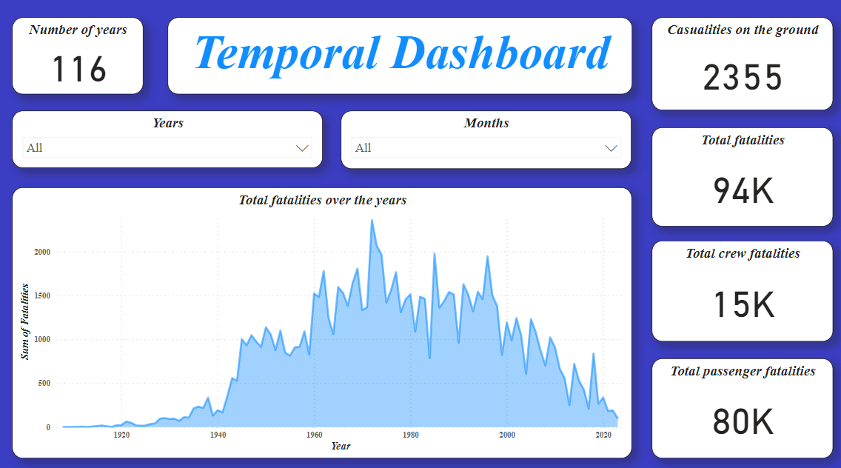
10

Slide 12
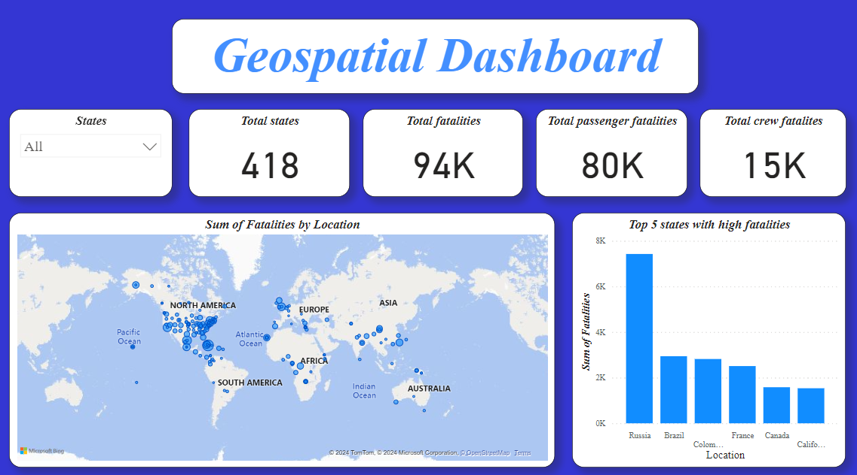
11

Slide 13
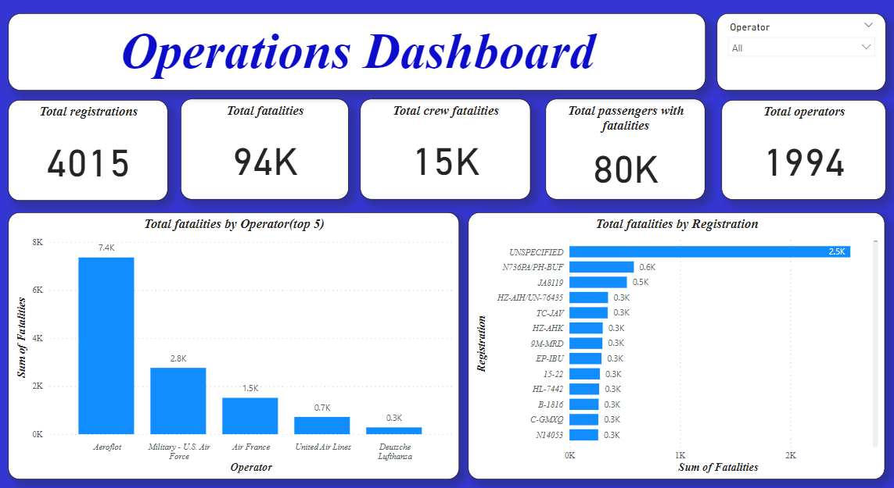
12

Slide 14
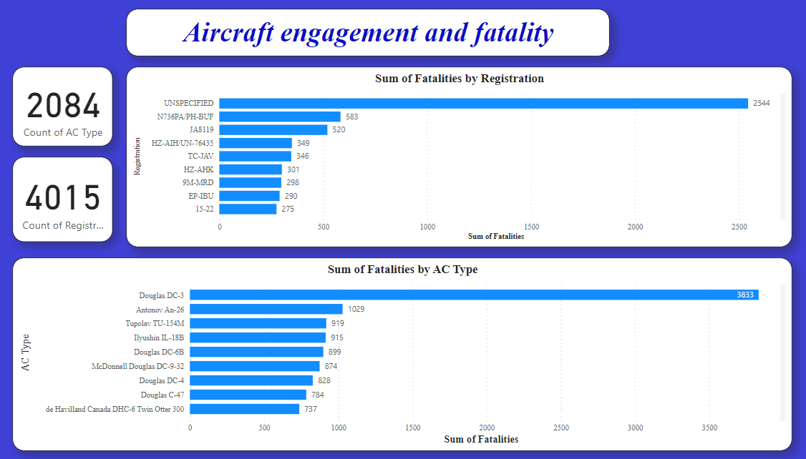
13

Slide 15
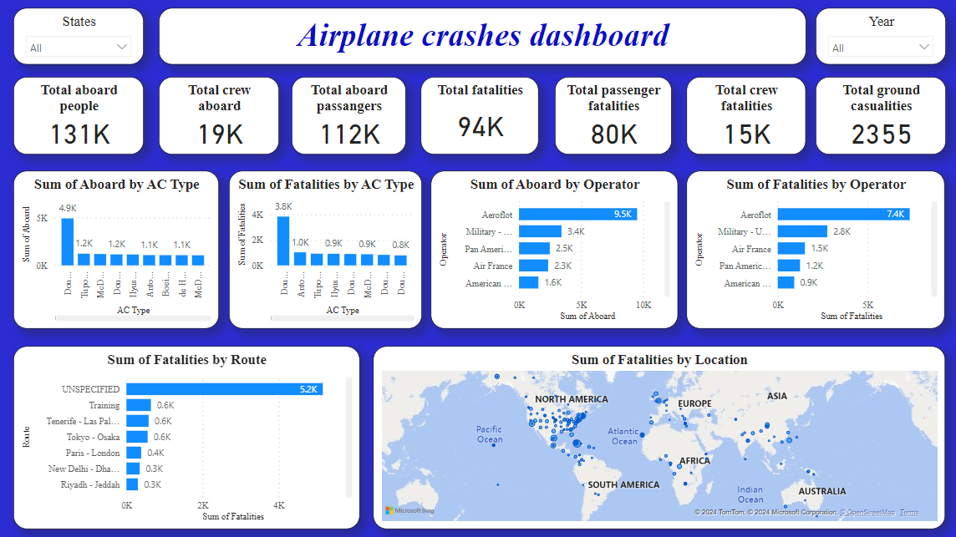
14

Slide 16
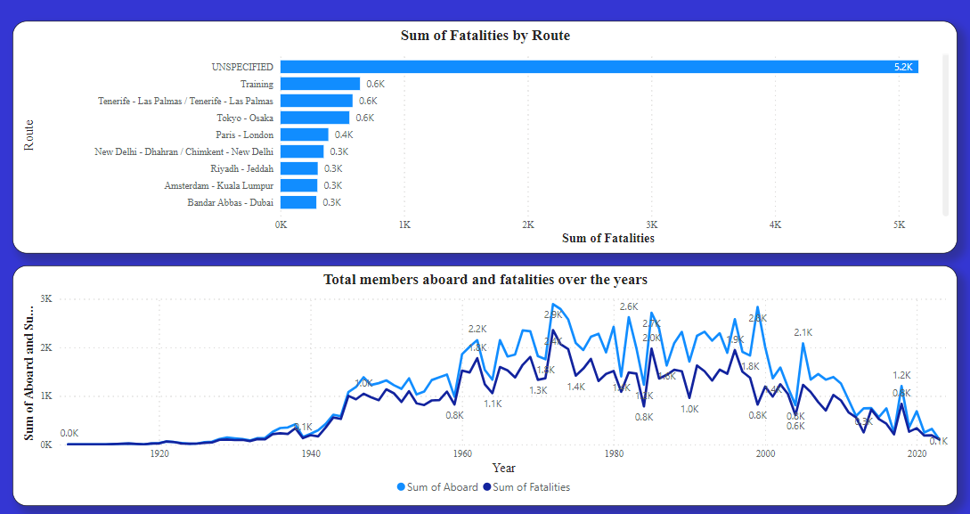
OTHER INSIGHTS
15

Slide 17

INSIGHTS
Most incidents happened in Russia
They were fatalities in 1972.
Aeroflot operator had more fatalities.
Most fatalities were unspecified, implying most registrations were not made.
Douglas D-3 had more fatality incidences
Routes with more fatalities were unspecified.
16

Slide 18
RECOMMENDATIONS
Registration should be encouraged all times.
A proper data collection strategy should introduced to ensure complete datasets for proper and more insightful analysis.
Routes should be always identified to enable proper solutions.
17

Slide 19

Mentorness Internship
THANK YOU
Presented By : Kevin Nabuule

